Slide 1


SUPPLIER DATA INTEGRATION

Slide 2

AGENDA
01
INTRODUCTION
02
INPUT KEY FACTS
03
CHANGES MADE
04
POTENTIAL CHANGES
05
CONCLUSION

Slide 3

OBJECTIVE
Our objective is onboarding new car suppliers efficiently.
METHOD
Integrating the product data coming from suppliers into the company’s present data structure.
THE CHALLENGE
INTRODUCTION
The details of the products in the input do not exactly match the details of the products that the company keep:
Input is in various formats, styles and languages.
Several product features that the company keeps are absent in the input.
And most of the ones which are actually present have different values for the same attributes.
ACTION PLAN
Transform, format and translate the input so that it matches the company data structure.
Identify methods to make up for the missing product features.

Slide 4
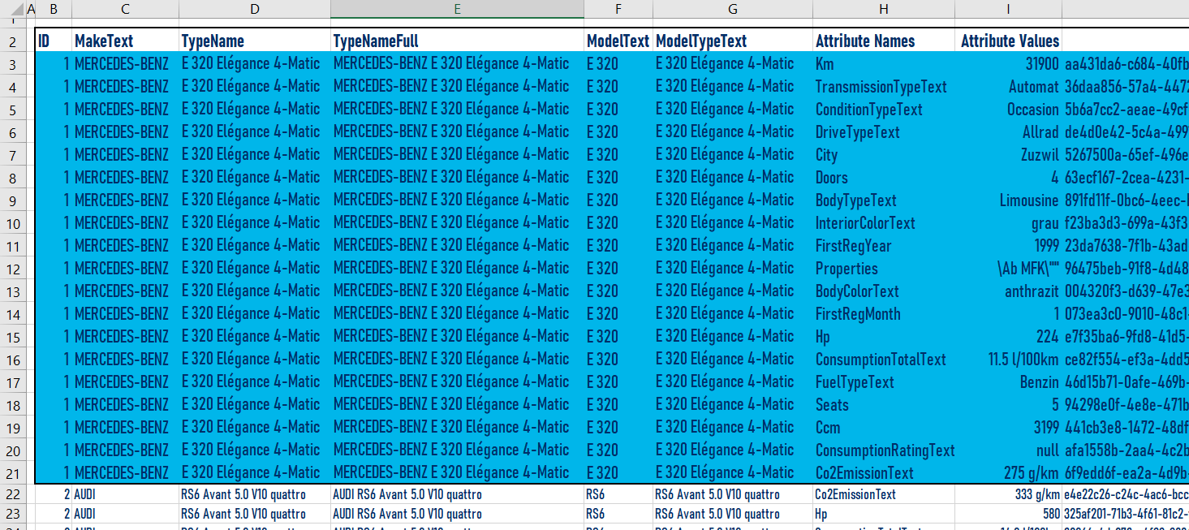
SUPPLIER DATA
Structure
For every single car, there are multiple records (as many as the car attributes provided):
INPUT
KEY FACTS
SUPPLIER
Integrity:
How many?
There are 21905 records => There are actually 1153 unique vehicles

Slide 5
SUPPLIER DATA
Compatibility
with company data:
Several features are not present in input:
Currency
Drive info (left-hand-drive / right-hand-drive)
Country
Price on request
Fuel consumption unit (Although this field can intuitively be populated using the ConsumptionTotalText data)
Several features are non-matching among the input and the company data:
Input has the first registration date whereas the company keeps the manufacture date.
Several model names and body types are contradictory.
Most of the zip data is null. And when not null, they are not zip codes but city names.
There are redundant attributes which do not have a counterpart at the company data such as:
Ccm, horse power, fuel type, CO2 emission rating, seats,
doors, etc.
INPUT
KEY FACTS
SUPPLIER

Slide 6
SUPPLIER DATA
Integrity:
There are two trucks, one trailer, one semi-trailer and one motorcycle amongst the input data.
303 products have their consumption info empty.
304 products have their type name empty.
949 products have their model name info empty.
3 products have their registration month info empty.
INPUT
KEY FACTS
SUPPLIER

Slide 7
COMPANY DATA
Integrity:
Several cars are recorded with wrong body types. Some examples are:
Bentley Continental GT V8 and Abarth S Coupé Werksrennwagen are recorded as saloon although they should be coupé.
Shelby Cobra by Superformance MKIII Roadster is recorded as saloon although it is a roadster.
Dodge RA SRT-10 is a pick-up truck. It is recorded as convertible.
City names are stored inconsistently.
Sometimes with a zip, sometimes without.
Some have notes appended to the city name.
There are even 4 records with the city name “Enter a location”.
There are several vehicles which are recorded as new cars but bear a mileage over 50’000 km.
INPUT
KEY FACTS
COMPANY

Slide 8
COMPANY DATA
Integrity:
There are several records with their make fields empty.
There are some records with irrelevant data like a 0 or 63 in their manufactured year fields.
Mileage data is recorded with scientific notation for several cars. For example:
One De Tomaso from Malle (BE) or one Porsche from Gütersloh (DE) have a mileage of 1.0E8 (100’000’000 km).
A great deal of mileage data is null (1139 records out of 7252).
INPUT
KEY FACTS
COMPANY

Slide 9
THE PROCESS AT A GLANCE
NORMALIZATION
This is the stage where we transform the data. Supplier records are translated, reformatted, styled to be ready to be merged with the target data. This stage together with integration is explained in more detail in the next slide.
CHANGES MADE
PRE-PROCESSING
INTEGRATION
Pre-processing is the stage where we check the encoding of the supplier data and group the records with respect to their ID’s so that we are left with exactly one record for each vehicle. Also the redundant columns are dropped at this stage.
This is the final stage where we merge the transformed data with the company’s own dataset. But before we merge, we add columns to the input dataset for the attributes which exist in the target dataset but not in the supplier input, such as price on request, currency or country.

Slide 10
There were certain records in the supplier data which were not passenger cars. The vehicle type is updated to “Other” for those.
Body types (coupé, sedan etc.) were kept differently in the supplier data. A body type mappings file in Excel format was created for these body types and the input was transformed accordingly.
There happened to be one record with no value in the body type field. It actually was a motorcycle, thus the absence of body type. Body type was set to “Other”.
There were some values which refer to the same make but with different names at the target and the source. A make mappings file in Excel format was created for those and the makes were transformed accordingly.
Supplier keeps a wider range of color data than that of the company. A color mappings file in Excel format was created for those and the colors were transformed accordingly.
Condition of the vehicle: Actually, the target dataset bears info like whether the vehicle has gone under a change of parts or not, whether it has been refurbished or not. The condition field in the source dataset, however, holds data about the age of car. For the time being, oldtimer and occasion cars were transformed as “Used” and “Neu” and “Vorführmodell” were transformed as “New”.
Price on request was one of the info which is not supplied by the supplier. There is no means to deduct the value of this field in the target dataset. However, 75% of the records in the target dataset were “False”. Assuming this field is to be manually updated by the customer, the supplier data was given a default value of “False”
CHANGES MADE
NORMALIZATION
INTEGRATION

Slide 11
All the changes mentioned in the previous slides could be automated so that the transformation and integration of the data process can be initiated by an operator.
As a next step, the process could be transformed into a fully automated one. For that end, the automated steps should be extended to include the extraction and loading of the supplier data.
In order to populate the country data from the input city data, a service or an API that communicates with GeoNames (or a similar database) could be utilized.
Please refer to the 7th and the 8th slides for the inconsistent, missing or erroneous attributes in the company database: Working together with the company, an automated method to heal / regenerate the company data could be formulated.
The data in question can be potentially integrated with company’s sales and CRM modules so that questions like below could be answered with more confidence:
Which make has the highest sales number?
Which customers segments prefer which makes, which body type, which color, which condition etc.?
Can we break the car data into several segments so as to understand customer behavior better and target customers accordingly?
Which car features should we include in the search filters on the website?
Which car features should we emphasize in our next campaign?
POTENTIAL
CHANGES

Slide 12
SUGGESTIONS
In order to be able to assess the current product set shrewdly and take sound decisions, the records should be accurate. We suggest that the inconsistent, missing or erroneous values in the car database are regenerated either manually or utilizing automation.
There is no matching field in the company dataset for many of the features which are actually present in the dataset provided by the supplier. These were treated as redundant and dropped. However, we believe that several of these unused features are actually significant to the product and the company could have made use of them, such as ccm, horse power, fuel type, CO2 emission rating.
Likewise, there are some data which remain empty after the integration as they are not provided by the supplier, such as currency and drive type. We believe that it would be for the benefit of the company if those kind of data were demanded from the suppliers.
CONCLUSION

